Slide 1


TITLE : IOT BASED SOLAR SKATING CYCLE
SUBTITLE : SKATE SMART
Presented by
AMBIKA A S
DEPT. OF ECE, DBIT
DATE
17/10/24
1/total slides

Slide 2
Outline of the Presentation
Introduction Background Methodology Data and Analysis
Conclusions
Introduction
Background
Methodology
Data and Analysis
Results and Conclusion

Slide 3
Introduction
Background
Methodology
Data and Analysis
Conclusions
Introduction
Motivation
Environment pollution is the foremost issue Indian face today. Pollution is also caused by vehicles.
Vehicles also face different issues like Traffic problems, increased fuel costs, investment problems, size, parking problems etc. Considering all the above problems solar Powered Electric Smart Skate Scooter is the best solution for a short distance travel.
Usage of solar renewable energy sources in scooters reduces the pollution. Small size of the scooter reduces the traffics and it also helps elderly people to travel short distance.
While considering the different aspects like Traffic problems, increased fuel costs, investment problems,size,parking problems etc,for all those problems we have a best solution of ‘Solar Powerd Small sized vechile’.

Slide 4
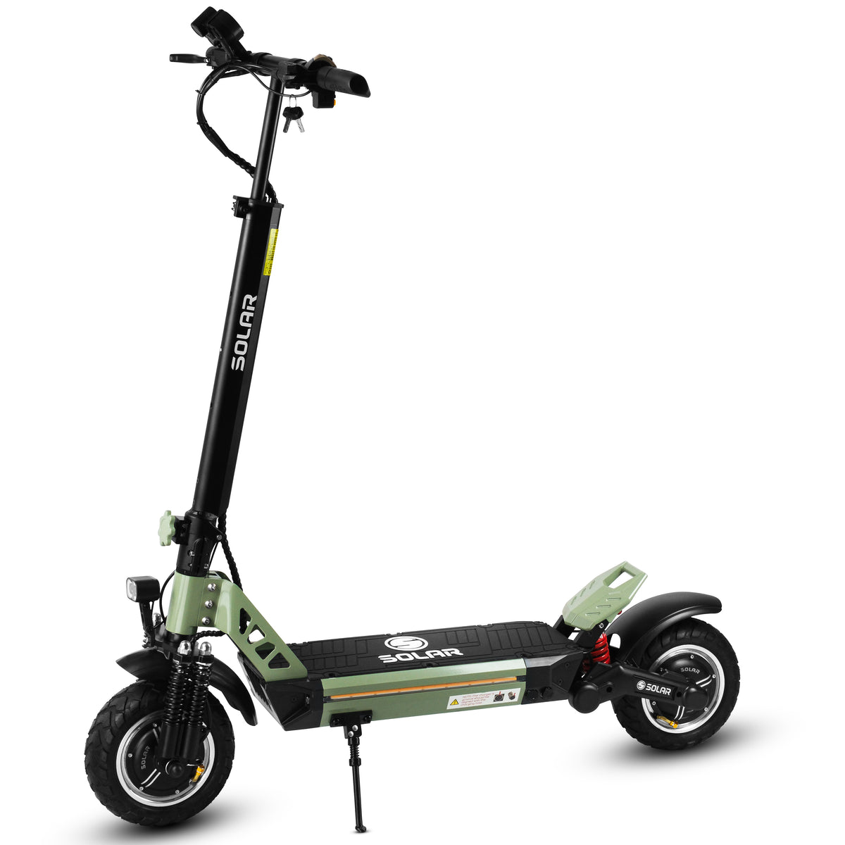
Data and Analysis
Introduction
Background
Methodology
Conclusions
The Electric Skate Board is a modern-day innovation which is completely rechargeable and has a battery backup of 2-3 hours in one single use.
The size of this skate board is small as compared to any commercial vehicle on the road.
As the size is small it solves our first problem of parking space.
It can used be effortlessly used on roads, college campus, large scale as well as small scale industries as a medium of transport.
This E-skate board has a capacity and capability to travel a short distance of 2-3km,with a battery backup of 2-3hrs.
Due to its small size which handy in nature it can easily pass-through traffic jams, by saving one's time.
This effort of using electric skate board is contributing to environment by not causing pollution in air.
A successfully working eco-friendly E-skate board was implemented.

Slide 5
Introduction Background
Background
Methodology
Data and Analysis
Conclusions
History
1. 1970s: First solar-powered vehicles (experimental cars).
2. 1980s: Solar-powered bicycles and tricycles.
3. 2000s: Solar-powered skateboards and skate cycles.
4. 2010s: Advancements in solar panel efficiency and battery technology.

Slide 6
Introduction Background Methodology Data and Analysis Conclusions
Literature Review
"Solar-Powered Electric Vehicles" (Journal of Solar Energy Engineering)
"Design and Development of Solar-Powered Skateboard" (International Journal of Mechanical Engineering)
"Energy Efficiency Analysis of Solar-Powered Bicycles" (Journal of Transportation Engineering)
"Solar-Powered Transportation: A Review" (Renewable and Sustainable Energy Reviews)

Slide 7
Introduction
Background
Methodology
Data and Analysis
Conclusions
Methodology
Solar Panel: Select appropriate solar panels based on the power requirement of the system.
Charge Controller:The solar panels will charge a battery that powers the motors and Arduino, allowing continuous operation during low sunlight conditions. Design a charging circuit to regulate the energy from the solar panels into the battery.
Switches and Controls: A switch or button to turn the system on/off .
Motor Driver: H-bridge motor driver or an electronic speed controller [ESC] to control the speed and direction.
Arduino Board: It controls the motor and other components.

Slide 8
Introduction
Background
Methodology
Data and Analysis
Conclusions
Solar panel
Charge Controller
Rechargeable battery
Current and Voltage Sensors
SKATE
CYCLE
Arduino Board
Motor Driver
Buzzer
DC Brushless Motor
PCB
PC / OLED Display
Mounting Hardware
Switches and Controls
Mounting Hardware
Switches and Controls

Slide 9
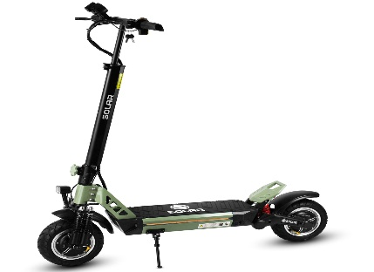
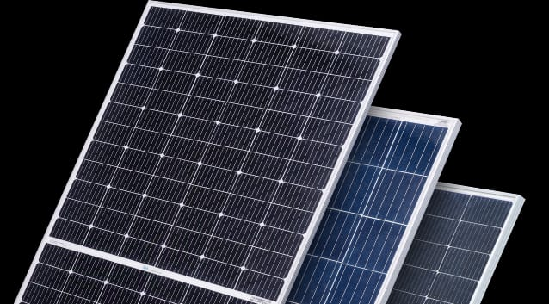
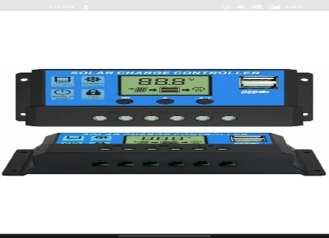
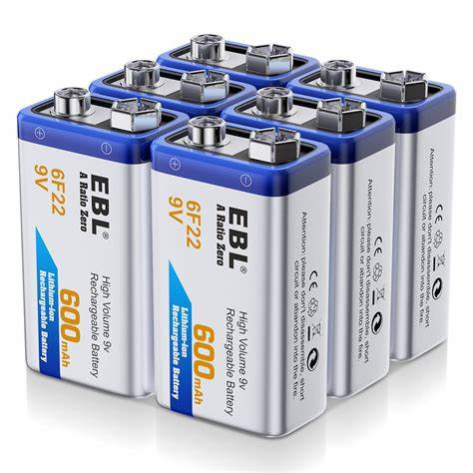
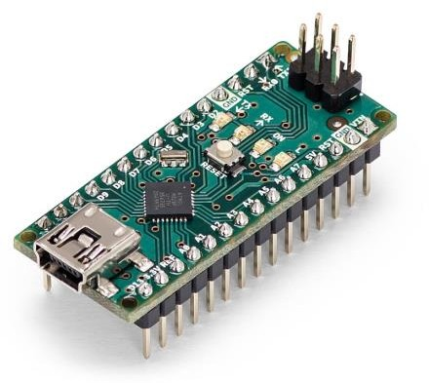
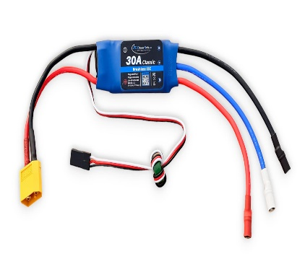
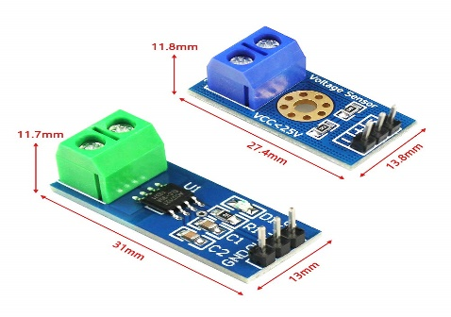
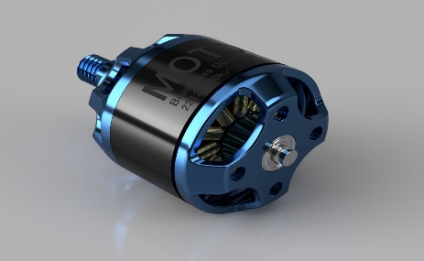
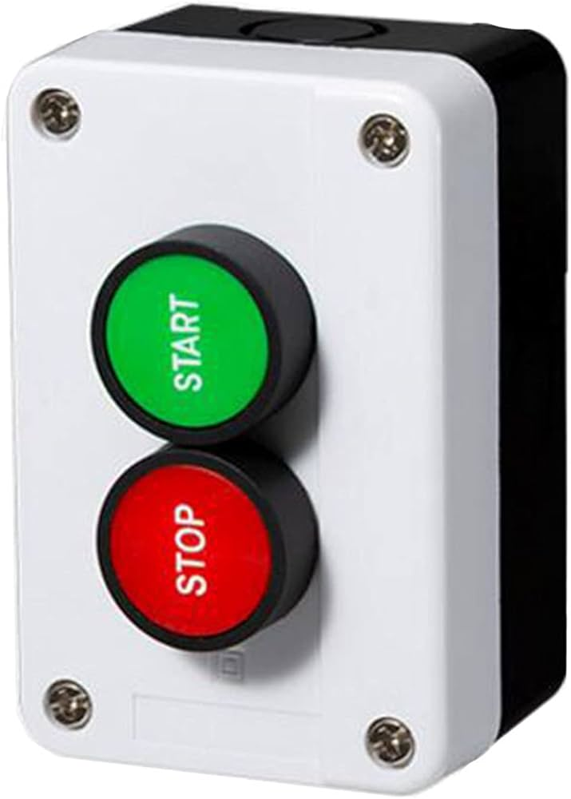
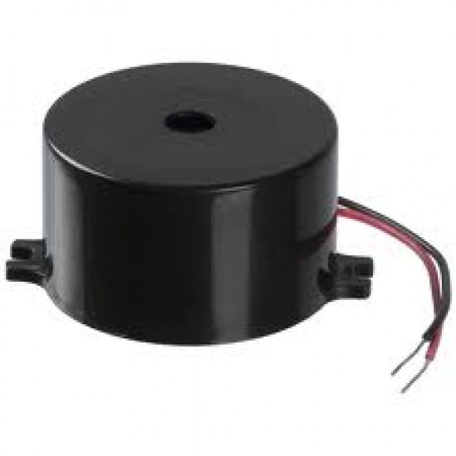
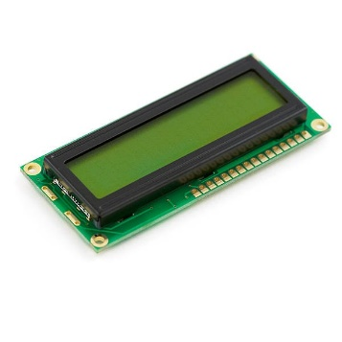
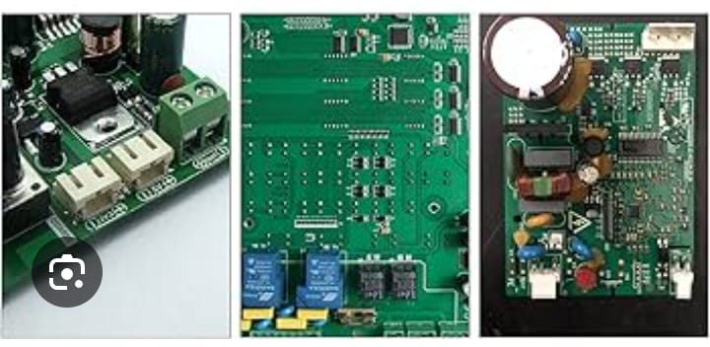
Hardware Components that are used:
Arduino Nano
Skating cycle
Solar Panel
Solar Charge Controller
Rechargeable Battery
DC Brushless Motor
Motor Driver
Current and voltage sensor
Buzzer
Switches and controls
LCD Display
Mounting hardware

Slide 10
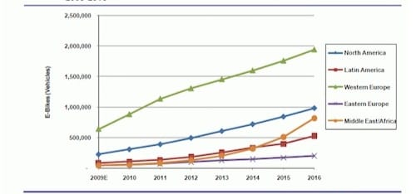
Introduction Background Methodology
Data and Analysis
Data and Analysis
Conclusions
•
Data analysis plays a very important or crucial role in solar skating cycle ,it shows how its gorwing day by day and it also predict the future scope.
Manufacturer Specifications: Data from producers regarding performance and features.
User Surveys: Collecting data directly from users to gauge satisfaction and performance.
Field Studies: Research conducted in real-world settings to test performance under various conditions

Slide 11
Introduction
Background
Methodology
Data and Analysis
Conclusions
Market Trends
Adoption Rates: How quickly solar skating cycles are being adopted in different regions.
Technological Advances: Innovations in solar technology that could improve efficiency
or reduce
Regulatory Support: Government policies promoting solar transportation solutions.
Data Analysis Techniques
Descriptive Statistics: Summarize the collected data (mean, median, standard deviation).
Correlation Analysis: Identify relationships between solar output and factors like weather conditions
Time Series Analysis: Analyze energy production and consumption trends over time.
Efficiency Calculation: Calculate the efficiency ratio (energy output vs. energy consumed).

Slide 12
Introduction Background
Conclusion
Summary
Methodology
Data and Analysis
Conclusions
The solar-powered skating cycle using Arduino is a innovative, eco-friendly, and cost-effective transportation solution. The project demonstrates the successful integration of solar energy harvesting, energy storage, and motor control using Arduino.
Eco-friendly transportation
Recreational activities (e.g., parks, beaches)
3. Short-distance commuting
4. Environmental education and awareness
5. Research and development in renewable energy and transportation

Slide 13
Introduction Background Methodology Data and Analysis Conclusions
Future scope
1. Improved Efficiency: Enhance solar panel efficiency, motor control, and gearbox optimization.
2. Advanced Materials: Integrate lightweight, durable materials (e.g., carbon fiber, graphene).
3. Smart Features: Develop GPS, Bluetooth, and Wi-Fi connectivity for real-time tracking and monitoring.
4. Safety Enhancements: Implement advanced braking systems, collision detection, and protective gear.
5. Mass Production: Scale up manufacturing to reduce costs and increase availability.

Slide 14
Thank You

Slide 15
References
https://www.researchgate.net/publication/349527735_Solar_Powered_Electric_Smart_Skate_Scooter_with_IoT
Chien-Ching Su and Kaohsiung Hsien “Solar Skateboard” U.S patent US20070272465A1, Nov. 29, 2007
Joerg D. Weigl , Low Wen Bin , Ayush Kumar Pacheriwala and Luo Yi1 “Multifunctional.
https://www.neliti.com/publications/428179/solar-powered-electric-skateboard
https://patents.google.com/patent/US20070272465A1/en
https://repo.ijiert.org/index.php/ijiert/article/download/1672/1573/3143

